Slide 1
Youth Crime and Youth Justice Overview 2018 Report
Bob Atkinson AO APM

Slide 3
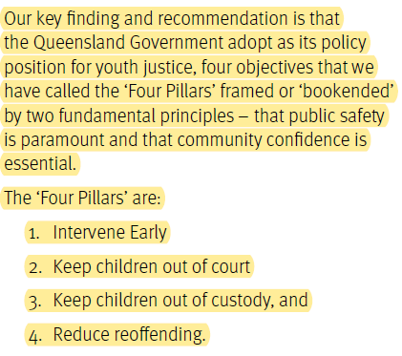
Executive Summary
Page 6

Slide 4
Damage Dozen
Foetal Alcohol Syndrome
Early Development (Vocabulary and Reading)
Domestic Violence
Overcrowding
Homelessness
Poverty
Nutrition – General Health
Poor Role Modelling
Mental Health
Formal Education (Truancy and Relocations)
Alcohol – Drugs
Abuse - Emotional, Physical, Sexual

Slide 5
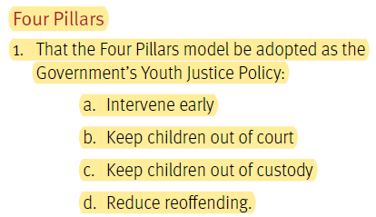
Recommendations - Four Pillars

Slide 6
Recommendations
Prevention and Early Intervention (4)
Education, Vocational Training and Employment (4)
Health and Wellbeing (2)
Substance Abuse (2)
Minor Offending (2)
Protected Admissions (1)
Bail (5)
Remand in Custody (2)

Slide 7
Recommendations
Restorative Justice (3)
Courts and Sentencing Options (3)
Detention (5)
Electronic Monitoring Devices (1)
BYDC and CYDC Human Resource Management (1)
Stand-alone Specialist Childrens Court (4)
Stand-alone Child Legislation (2)
Legal Representation in the Children’s Criminal Jurisdiction (2)

Slide 8
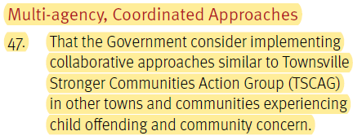
Recommendations – Multi-agency Coordinated Approaches

Slide 9
Recommendations
Place Based Approaches (1)
Information Sharing (1)
Non-Government Services and Programs (1)
After-Hours Services (5)
Community Champions (1)
Drivers Licenses and Support Programs (1)

Slide 10
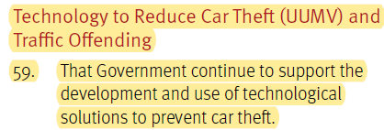
Recommendations – Technology to Reduce Car Theft (UUMV) and Traffic Offending

Slide 11
Recommendations
Role of Key Agency Group and Regional Cross-Agency Coordination (2)
Measuring Success (3)
Media (1)
Research, Evaluation and Knowledge Dissemination (1)

Slide 12
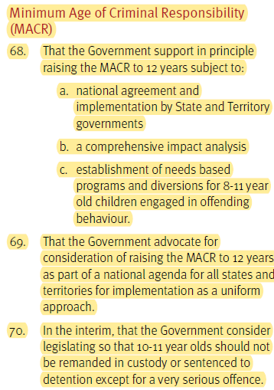
Recommendations – Minimum Age of Criminal Responsibility

Slide 13
Recommendations
Aboriginal and Torre Strait Islander Over-representation (5)

Slide 14
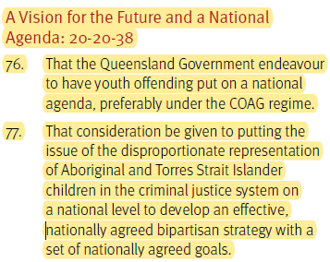
Recommendations – A Vision for the Future and a National Agenda 20-20-38

Slide 15
Technology to Prevent Car Theft - Discussion

Slide 16
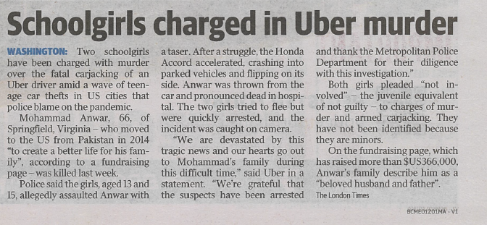
Tuesday March 30 2021 Courier Mail

Slide 17
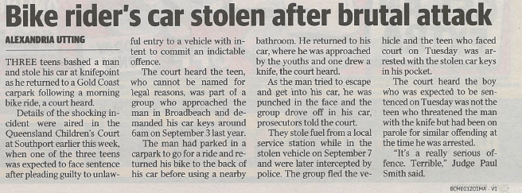
Sunday April 3 2021 Courier Mail

Slide 18
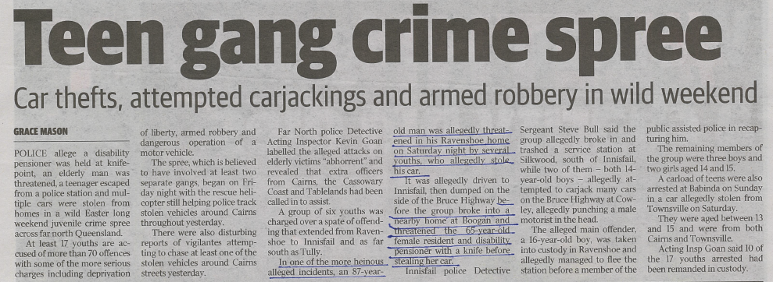
Tuesday April 6 2021 Courier Mail

Slide 19
Report on Youth Justice from Bob Atkinson AO, APM, Special Adviser to Di Farmer MP, Minister for Child Safety, Youth and women and minister for Women and Minister for Prevention of Domestic and Family Violence
See report:
https://www.youthjustice.qld.gov.au/reform/youth-justice-strategy/atkinson-report-youth-justice

